Slide 1
What you need to know about Financial Aid
What You Need to Know About Financial Aid
Jayne Dinse
Financial Aid Director
South Central College
Jayne Dinse
Financial Aid Director

Slide 2
Topics We Will Discuss
What is financial aid?
Cost of attendance (COA)
Expected family contribution (EFC)
Financial need
Categories, types, and sources of financial aid
Free Application for Federal Student Aid (FAFSA®)
Special circumstances

Slide 3
What is Financial Aid?
Financial aid consists of funds provided to students and families to help pay for postsecondary educational expenses
What is Financial Need?
Cost of attendance (COA)
– Expected family contribution (EFC)
= Financial need

Slide 4
What is Cost of Attendance (COA)?
Tuition and fees
Room and board
Books and supplies
Transportation
Miscellaneous personal expenses

Slide 5
What is Expected Family Contribution (EFC)?
Measurement of student’s and family’s ability to pay postsecondary educational expenses
Student contribution
Parent contribution
(for dependent students)

Slide 6
Categories of Financial Aid
Need-based aid
Non-need-based aid

Slide 7
Types of Financial Aid
Scholarships
Grants
Work-Study Employment
Loans
Self-Help Aid
Gift Aid

Slide 8
Federal Government
Largest source of financial aid
Aid awarded primarily on the basis of financial need
Must apply each year using the FAFSA
Eligibility requirements must be met

Slide 9
Federal Student Aid Programs
Federal Pell Grant
Federal Supplemental Educational Opportunity Grant (FSEOG)
Teacher Education Assistance for College and Higher Education (TEACH) Grant
Federal Work-Study (FWS)
Federal Direct Student Loans (Direct Loans)
Iraq Afghanistan Service Grant
Federal PLUS Loans

Slide 10
States
Residency requirements usually apply
Award aid on the basis of both merit and need
Use information from the FAFSA and/or state aid applications
Deadlines vary by state

Slide 11
State Student Aid Programs
Minnesota State Grant
DREAM Act
State Work Study
MN Indian Scholarship
Post Secondary Child Care Grant
Minnesota GI Bill
Public Safety Officer’s Survivors Grant
SELF Loans

Slide 12
Other sources
Colleges and Universities
(aid provided on basis of need and merit)
Foundations, Businesses, Civic, Charitable
Organizations
Employers
(scholarships and educational benefits)

Slide 13
Free Application for Federal Student Aid (FAFSA®)
Collects demographic and financial information
Information used to calculate the expected family contribution (EFC)
Colleges use EFC to award financial aid
Available in English and Spanish

Slide 14
Free Application for Federal Student Aid (FAFSA®)
May be filed at any time during an academic year, but no earlier than October 1st prior to the academic year for which the student requests aid
For the 2021-22 academic year, the FAFSA -may be filed beginning October 1, 2020
Colleges may set FAFSA priority dates

Slide 15
Free Application for Federal Student Aid (FAFSA®)
FAFSA on the Web (FOTW)
myStudentAid mobile app
Paper or PDF FAFSA
FAA Access to CPS Online
FAFSA on the Phone (FOTP)

Slide 16
Benefits of Using FOTW or myStudentAid
Built-in edits to prevent costly errors
Skip-logic allows student and/or parent to skip unnecessary questions
Option to use Internal Revenue Service (IRS) Data Retrieval Tool to import tax data
More timely submission of original application and any necessary corrections
More detailed instructions and “help” for common questions
Ability to check application status online
Simplified application process in the future

Slide 17
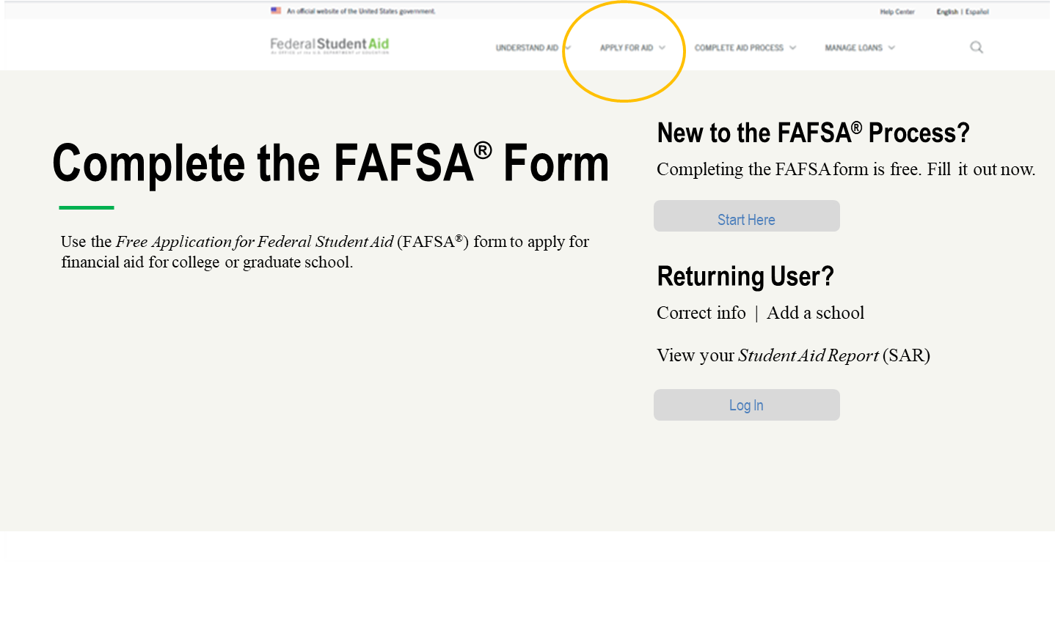
FAFSA on the Web (FOTW)
Website: https://studentaid.gov/h/apply-for-aid/fafsa

Slide 18
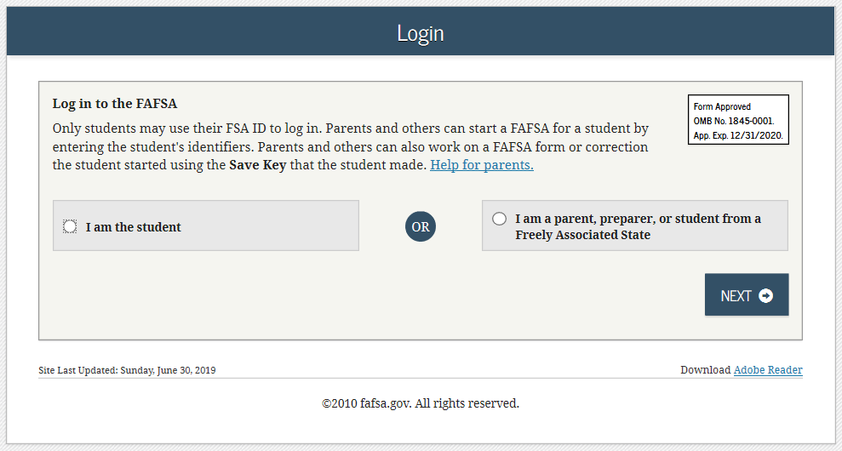
FAFSA on the Web (FOTW)

Slide 19
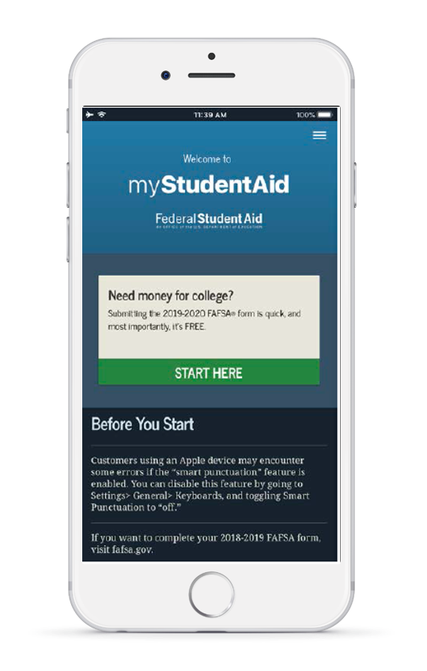
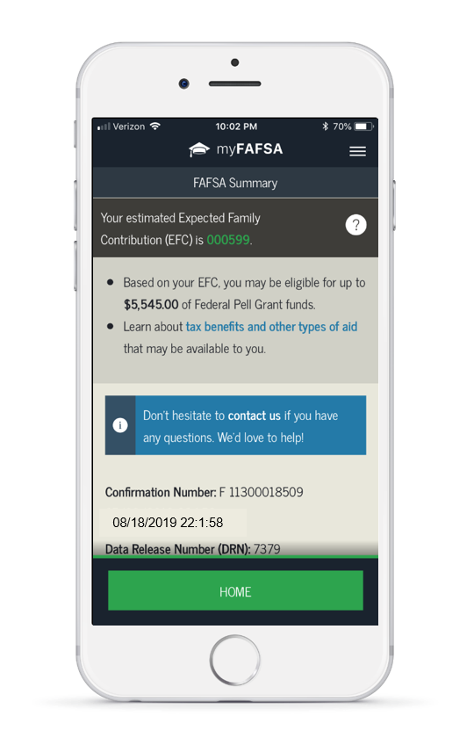
myStudentAid Mobile App
Mobile ability to begin, complete, save, and submit the FAFSA
Prompts applicant to create a save key, allowing completion at later time
FAFSA completion tracked
Successful completion of each section indicated
Agreement of Terms checkbox
Confirmation of submission
Estimated EFC calculation

Slide 20
IRS Data Retrieval Tool (DRT)
Allows for certain tax return information to be transferred from the IRS database
Participation is voluntary and student chooses whether or not to transfer data to FOTW
IRS will authenticate taxpayer’s identity
If tax record is found, IRS transfers information to populate the FAFSA
Reduces documents requested by financial aid office

Slide 21
IRS Data Retrieval Tool
Certain tax filers cannot use the
IRS Data Retrieval Tool
Did not indicate on FAFSA a tax return was completed
Marriage date is January 2019, or later
First three digits of the SSN are 666
Filed a non-U.S. tax return
Married and filed as head of household, or filed separate returns
Neither married parent entered a valid SSN
Non-married parent or both married parents entered all zeroes for the SSN

Slide 22
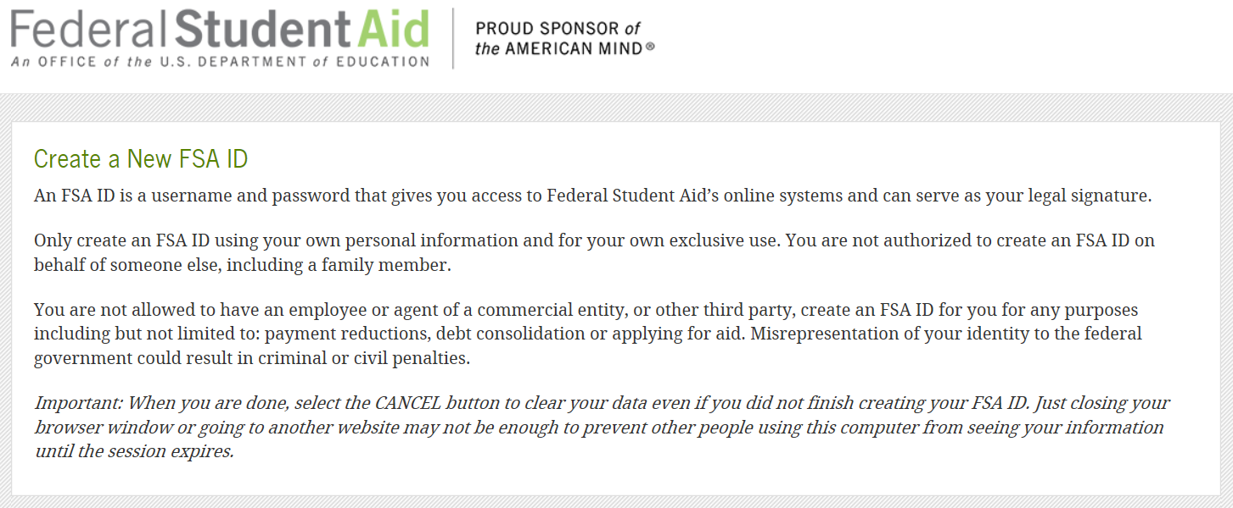
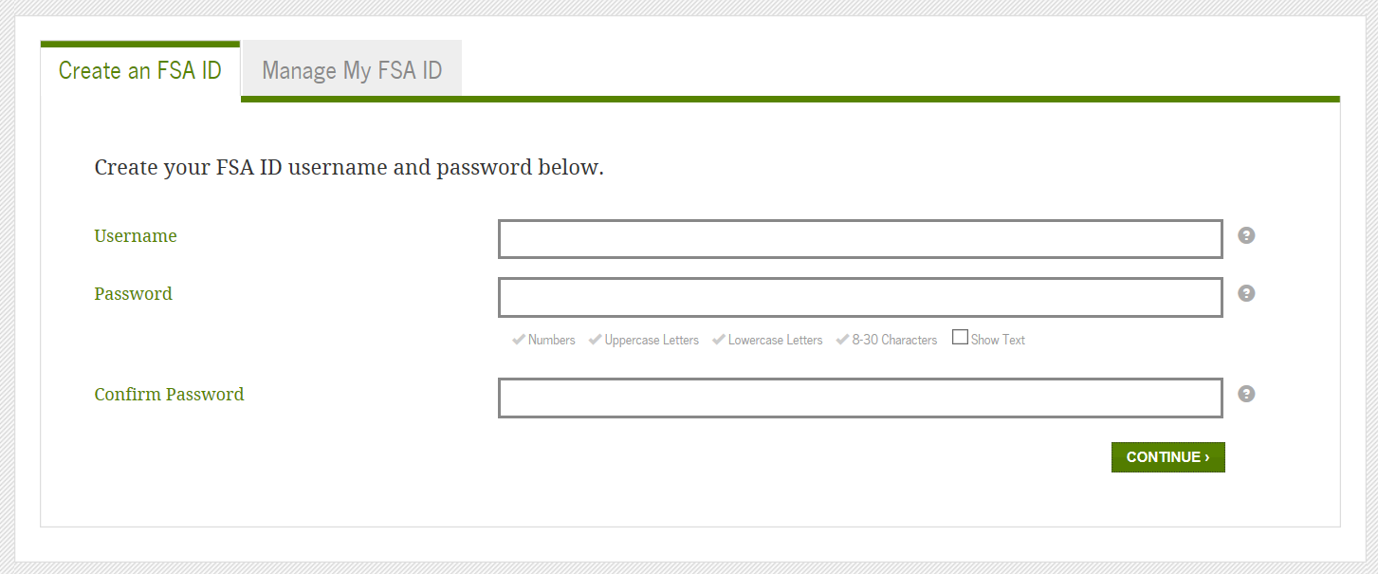
FSA ID
Used for FAFSA completion and allows access to certain U.S. Department of Education websites
May be used by students and parents throughout financial aid process, including subsequent school years
Only the owner should create a FSA ID
Apply at https://fsaid.ed.gov/npas/index.htm

Slide 23
General Student Information
Social Security Number
Citizenship status
Marital status
Drug conviction of possession or sale
Selective Service registration
Highest education level completed by father/mother

Slide 24
Student Dependency Status
FAFSA asks questions to determine dependency status for Title IV federal student aid (not IRS) purposes:
If all “No” responses, student is dependent
If “Yes” to any question, student is independent

Slide 25
Information About Parents of Dependent Students
Tax, income, and other financial information
Dislocated worker status
Receipt of means-tested federal benefits in the previous two years
Assets
Untaxed income

Slide 26
Information About Student (and Spouse)
Tax, income, and other financial information
Dislocated worker status
Receipt of means-tested federal benefits in the previous two years
Assets
Untaxed income

Slide 27
Additional Information
College Information
Housing Plans
FAFSA preparer information
Signatures Required
Student
One parent (dependent students)
Format for submitting signatures
Electronic using FSA ID
Signature page
Paper FAFSA

Slide 28
Frequent FAFSA Errors
Social Security Numbers
Divorced/widowed/remarried parental information
Income earned by parent/stepparent
Untaxed income
U.S. income taxes paid
Household size
Number of household members in college
Real estate and investment net worth

Slide 29
FAFSA Processing Results
CPS
College
Student

Slide 30
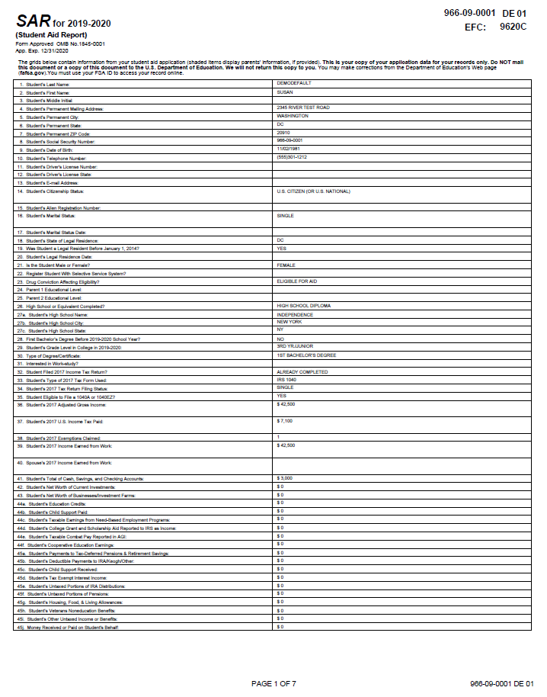
Email Notification of SAR Processing
If valid email address is provided on FAFSA
Provides access to electronic SAR at www.fafsa.gov

Slide 31
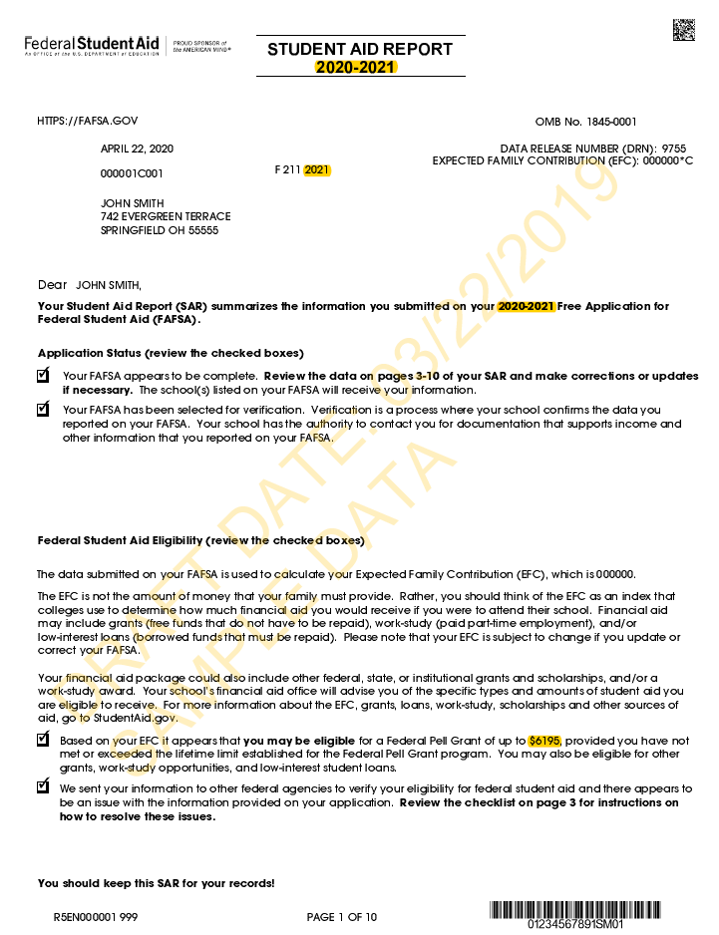
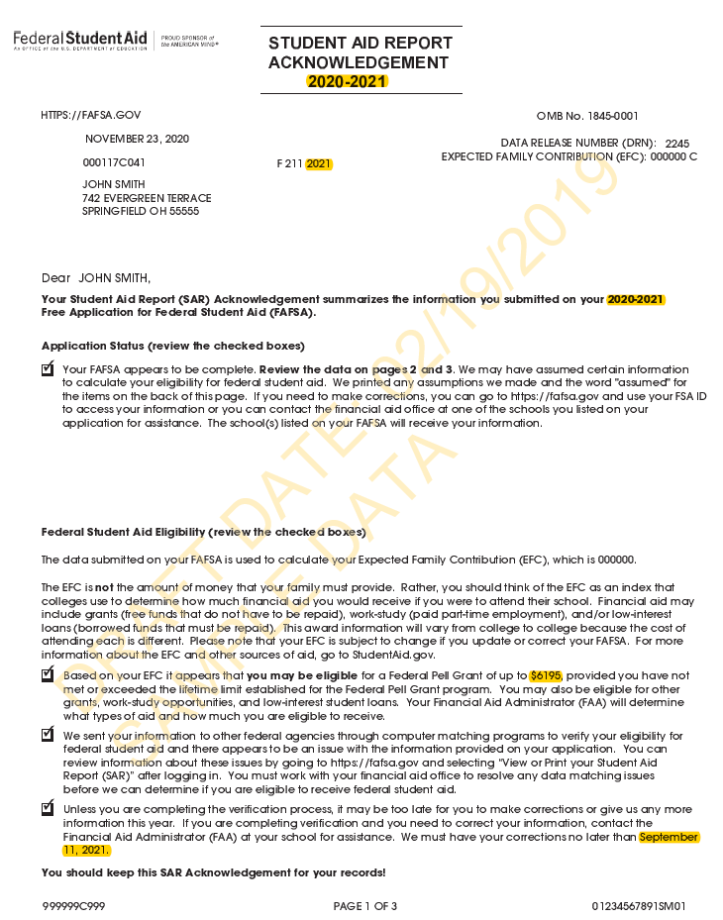
SAR or SAR Acknowledgement
SAR sent if paper FAFSA filed without providing an email address
SAR Acknowledgement sent if FOTW filed without providing an email address

Slide 32
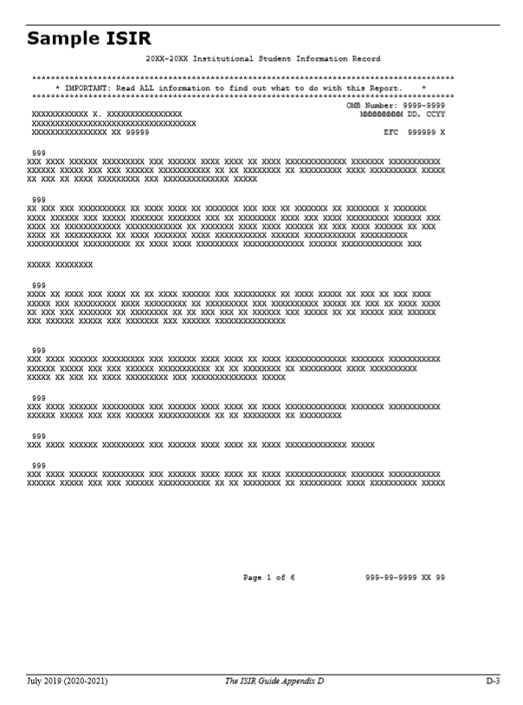
Institutional Student Information Record (ISIR)
CPS sends results to colleges listed on the FAFSA
College reviews ISIR and may request additional documentation

Slide 33
Making Corrections
If necessary, corrections to FAFSA data may be made by:
Using FAFSA on the Web, if student has a FSA ID;
Updating paper SAR; or
Submitting documentation to college’s financial aid office.

Slide 34
Special Circumstances
Conditions exist that cannot be documented with the FAFSA
Send written explanation and documentation to your college’s financial aid office
College will review and request additional information if necessary
Decisions are final and cannot be appealed to U.S. Department of Education

Slide 35
Special Circumstances
Secondary school tuition
Unusual uncovered medical/dental expenses
Extraordinary dependent care
Student cannot obtain parental information
Parent or spouse death
Loss of employment
Divorce

Slide 36
Questions
Jayne Dinse
jayne.dinse@southcentral.edu
financialaid@southcentral.edu 507.389.7269

